Slide 1
QAPISHIELD -
DEEPFAKE VOICE DETECTION
MEENAKSHY S KUMAR

Slide 2
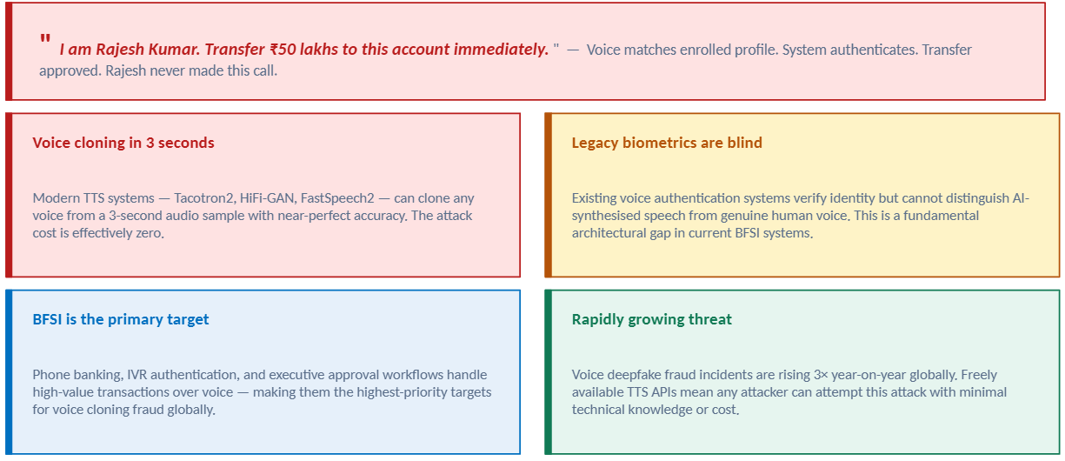
PROBLEM STATEMENT

Slide 3
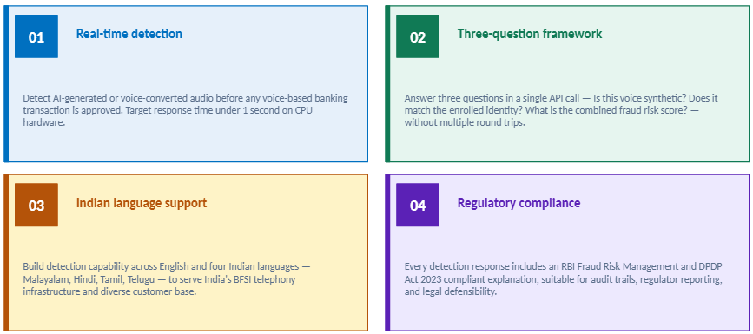
OBJECTIVE

Slide 4
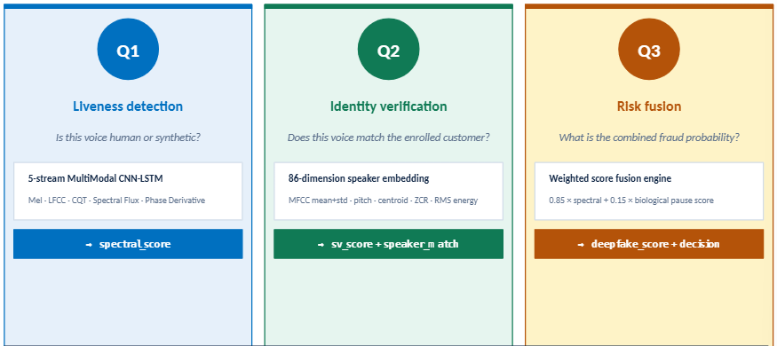
CORE IDEA
The Three-Question Detection Framework
Decision engine: ALLOW / STEP_UP / BLOCK Trigger: MFA, device isolation, blockchain audit log

Slide 5
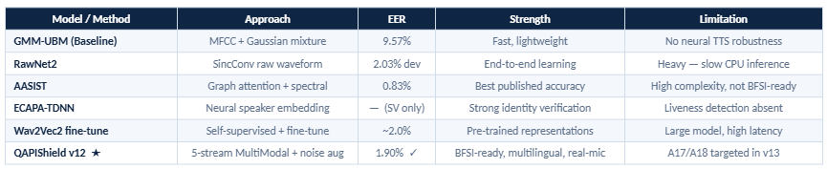
EXISTING ALGORITHM
Key insight: Existing models fail on A17/A18 neural TTS (Tacotron2 + HiFi-GAN) because mel spectrogram features cannot capture phase incoherence of neural vocoders

Slide 6
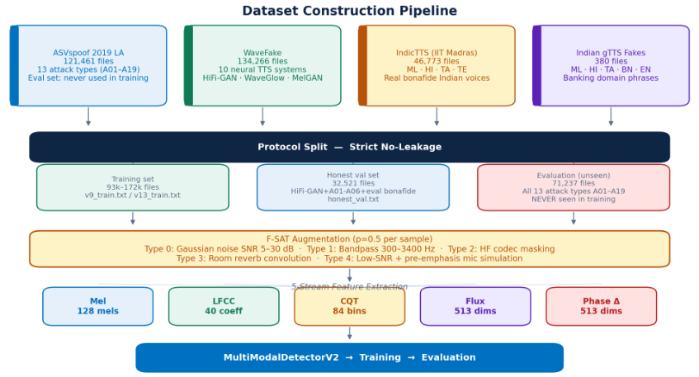
DATASET CONSTRUCTION PIPELINE
Fig 1: Dataset Construction Pipeline

Slide 7
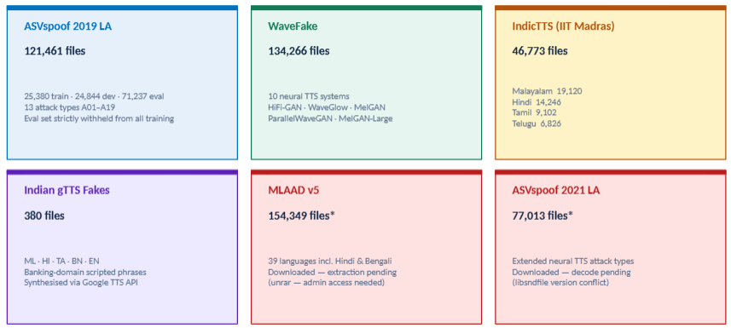
PHASE 1- DATASET COLLECTION

Slide 8
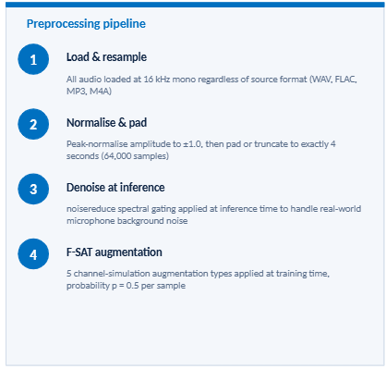
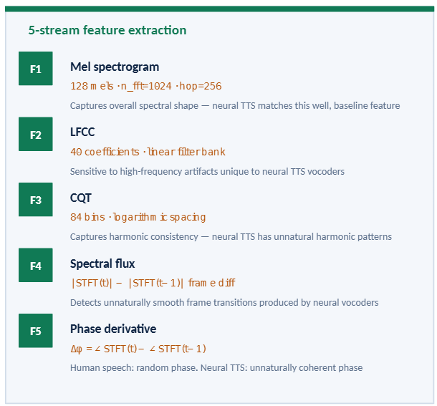
PHASE 2- PREPROCESSING & FEATURE ENGINEERING

Slide 9
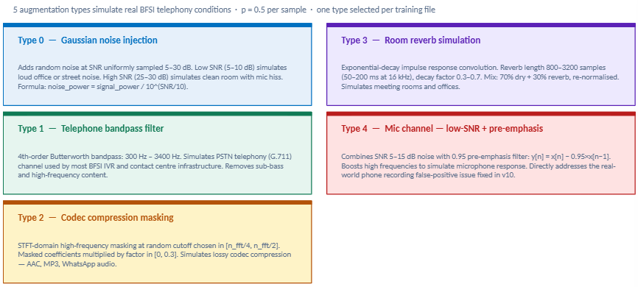
PHASE 2- FSAT AUGMENTATION DETAIL

Slide 10
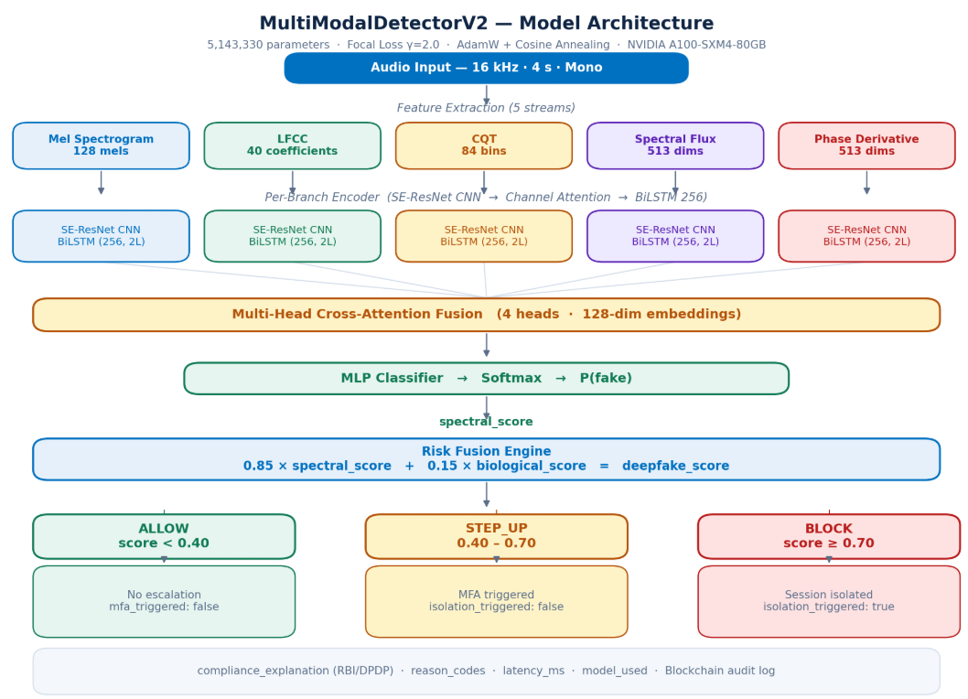
PHASE 3- MODEL ARCHITECTURE
Fig 2: Model Architecture

Slide 11
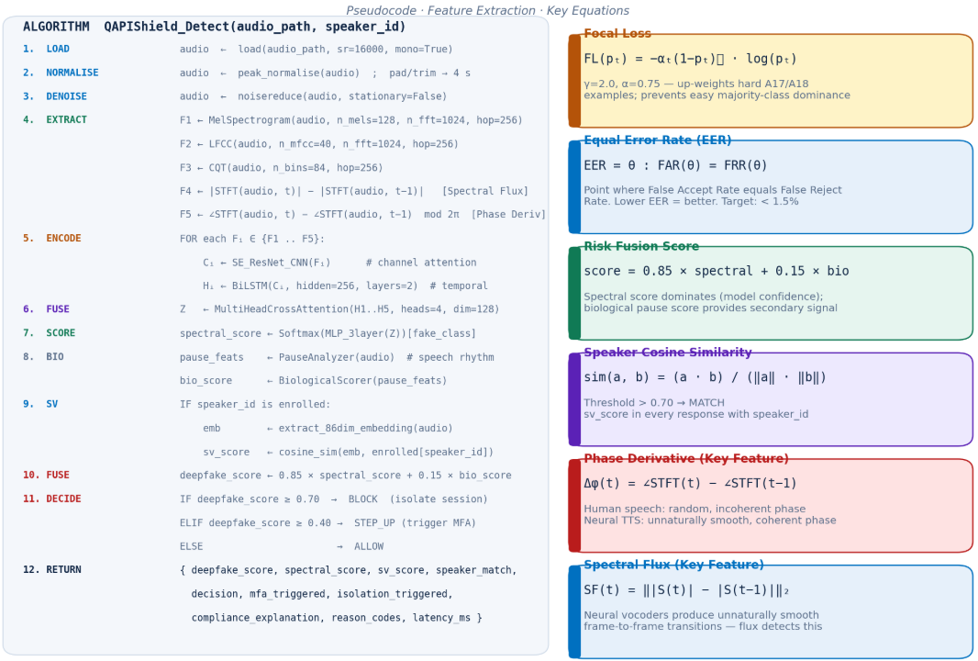
PROPOSED ALGORITHM

Slide 12
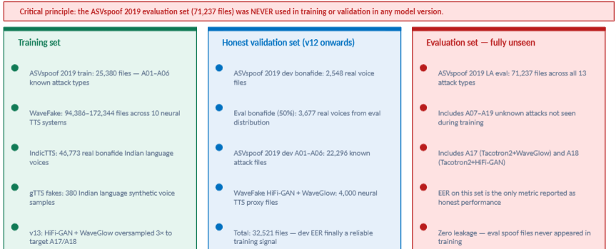
PHASE 3- TRAINING STRATEGY & PROTOCOL DESIGN

Slide 13
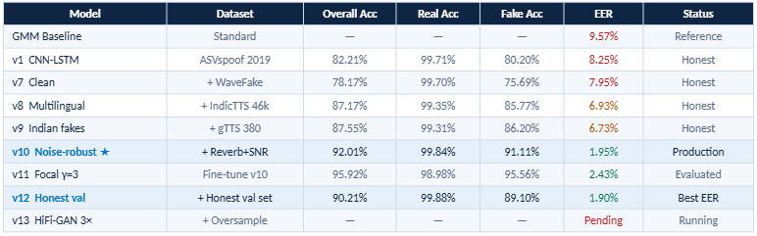
PHASE 3- EVALUATION RESULTS
  v10- noise augmentattion caused the biggest single improvement (6.37% - 1.95% EER)
  All honest models evaluated on 71, 237 completely unseen files - zero eval-set spoof data used in training
  A17/A18 neural TTS remains the hardest challenge - v13 HiFi GAN 3x oversampling directly targets this gap.

Slide 14
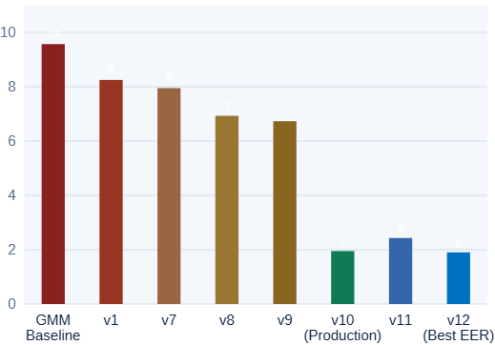
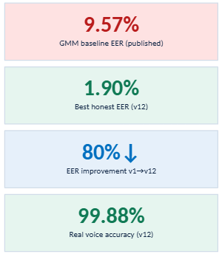
PHASE 3- EER PROGRESSION
v10- noise augmentattion (room reverb + SNR 5-25dB). drove EER from 6.37% → 1.95% - the single largest improvement across all versions.

Slide 15
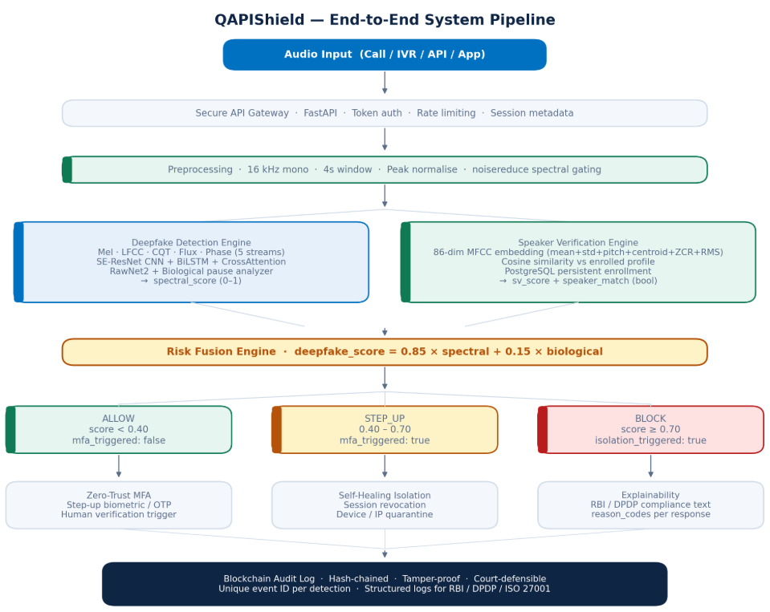
END-TO-END SYSTEM PIPELINE
Fig 3: End-to-end System Pipeline

Slide 16
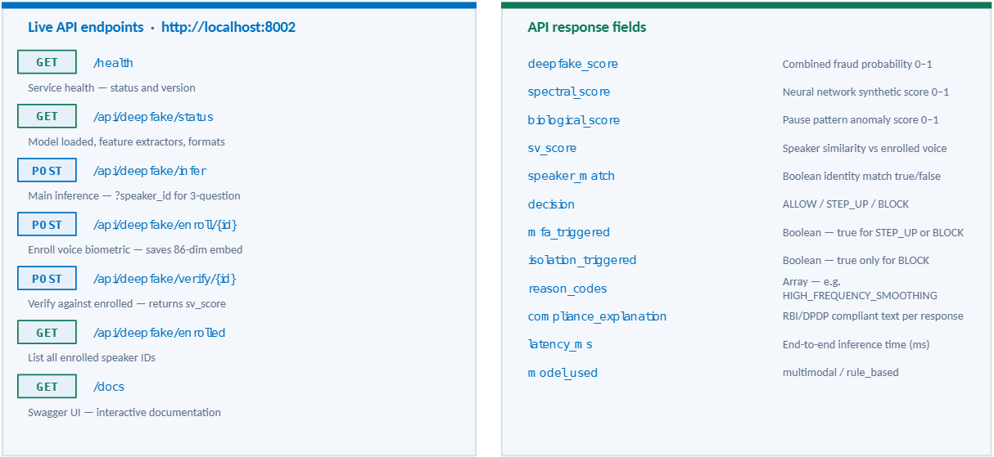
PHASE 4- MICROSERVICE DEPLOYMENT

Slide 17
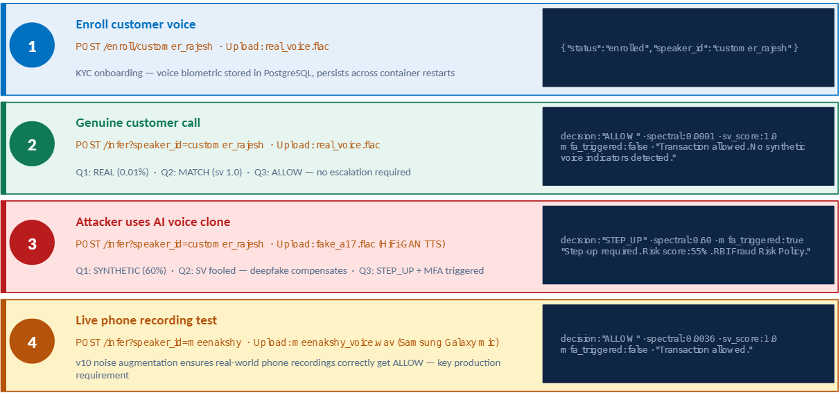
THE THREE QUESTIONS DETECTION FLOW

Slide 18
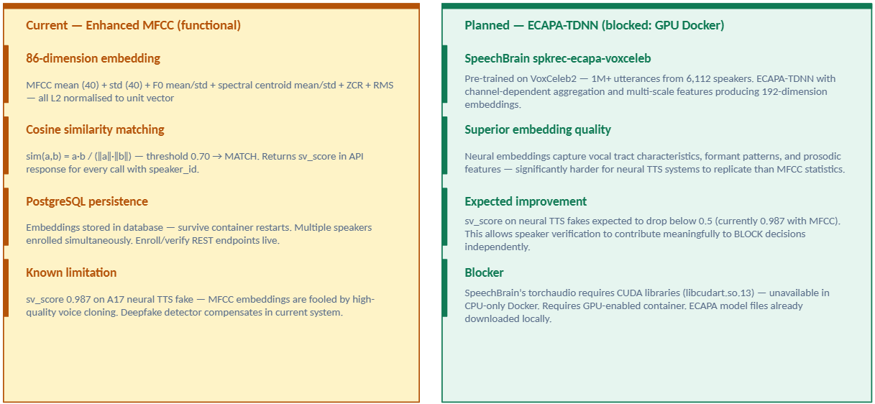
PHASE 4- SPEAKER VERIFICATION

Slide 19
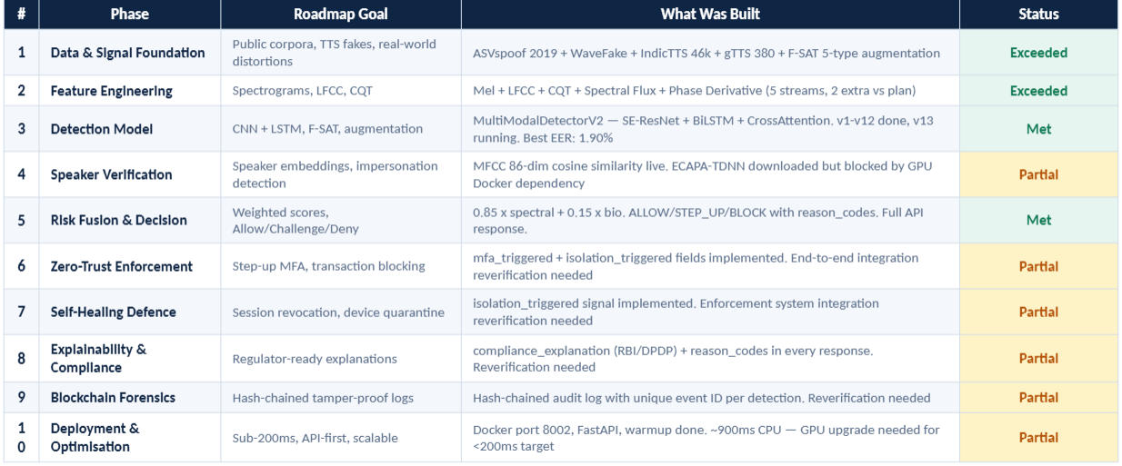
ROADMAP ALIGNMENT

Slide 20
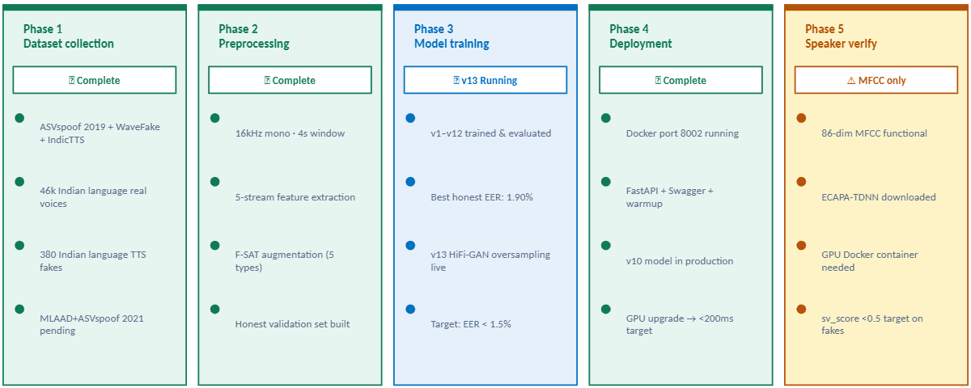
DEVELOPMENT ROADMAP

Slide 21
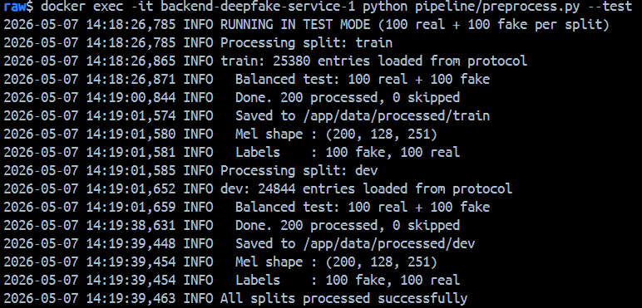
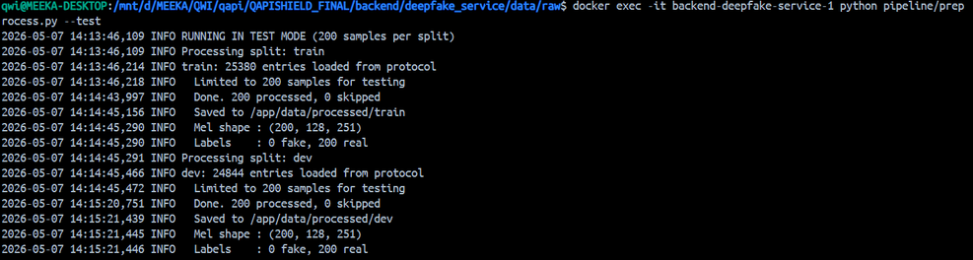
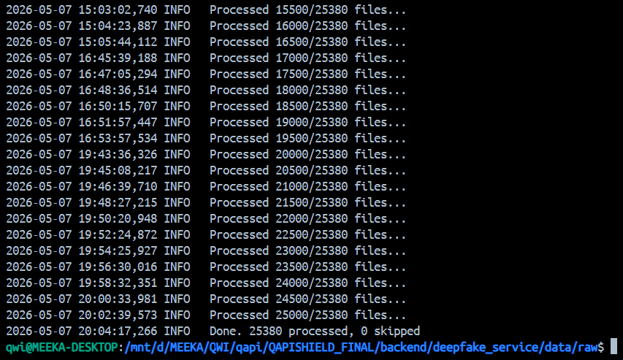
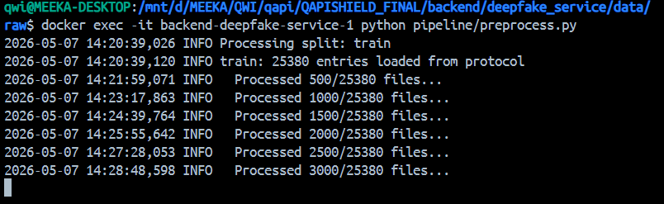
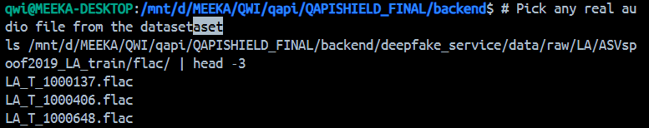
RESULTS
Fig 4: Docker Backend Processing

Slide 22
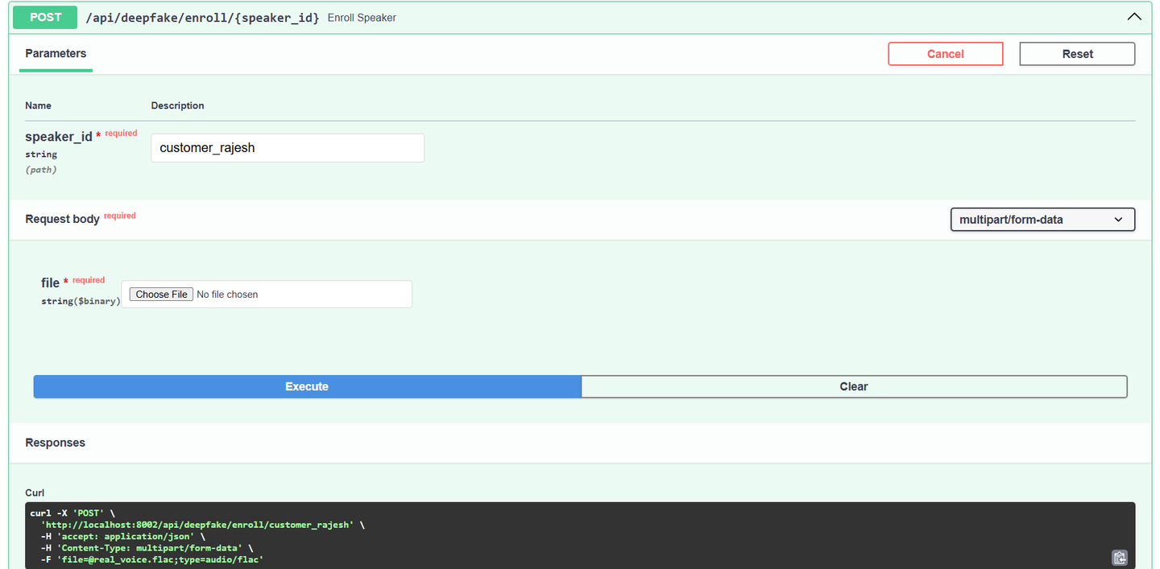
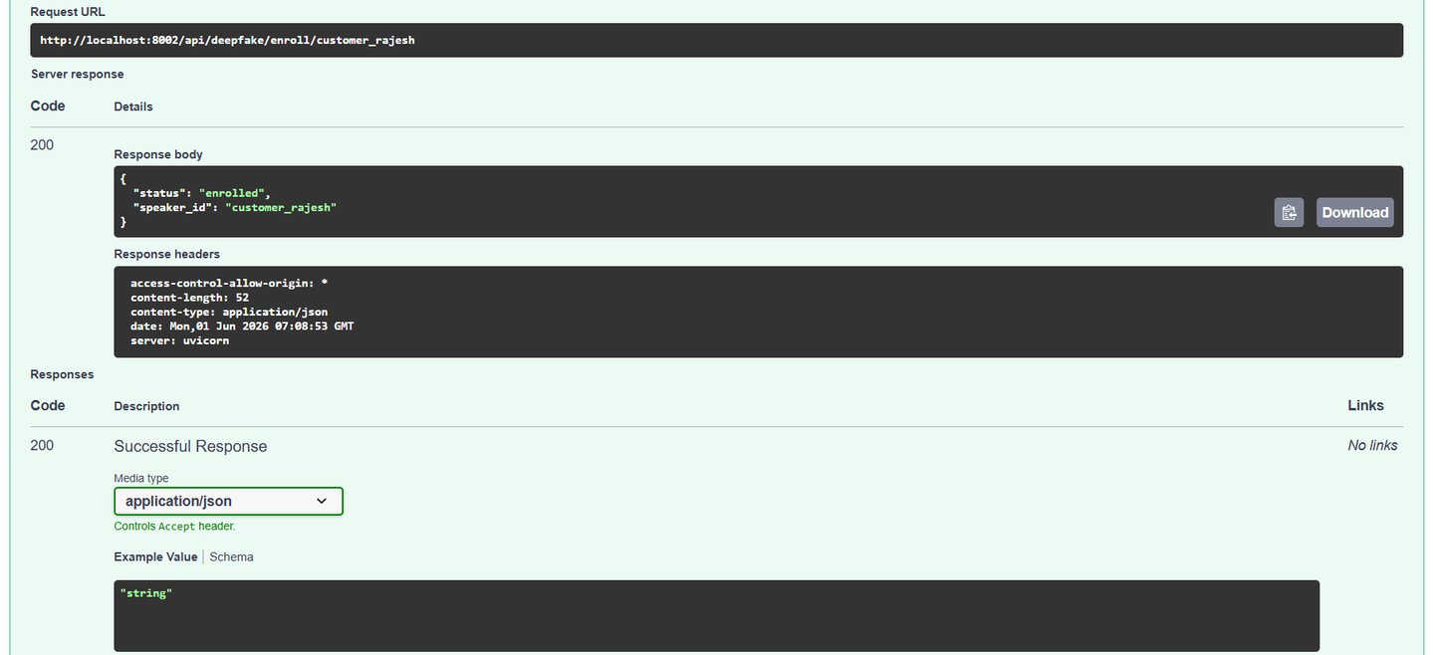
RESULTS
Fig 5: Swagger API- speaker enrollment

Slide 23
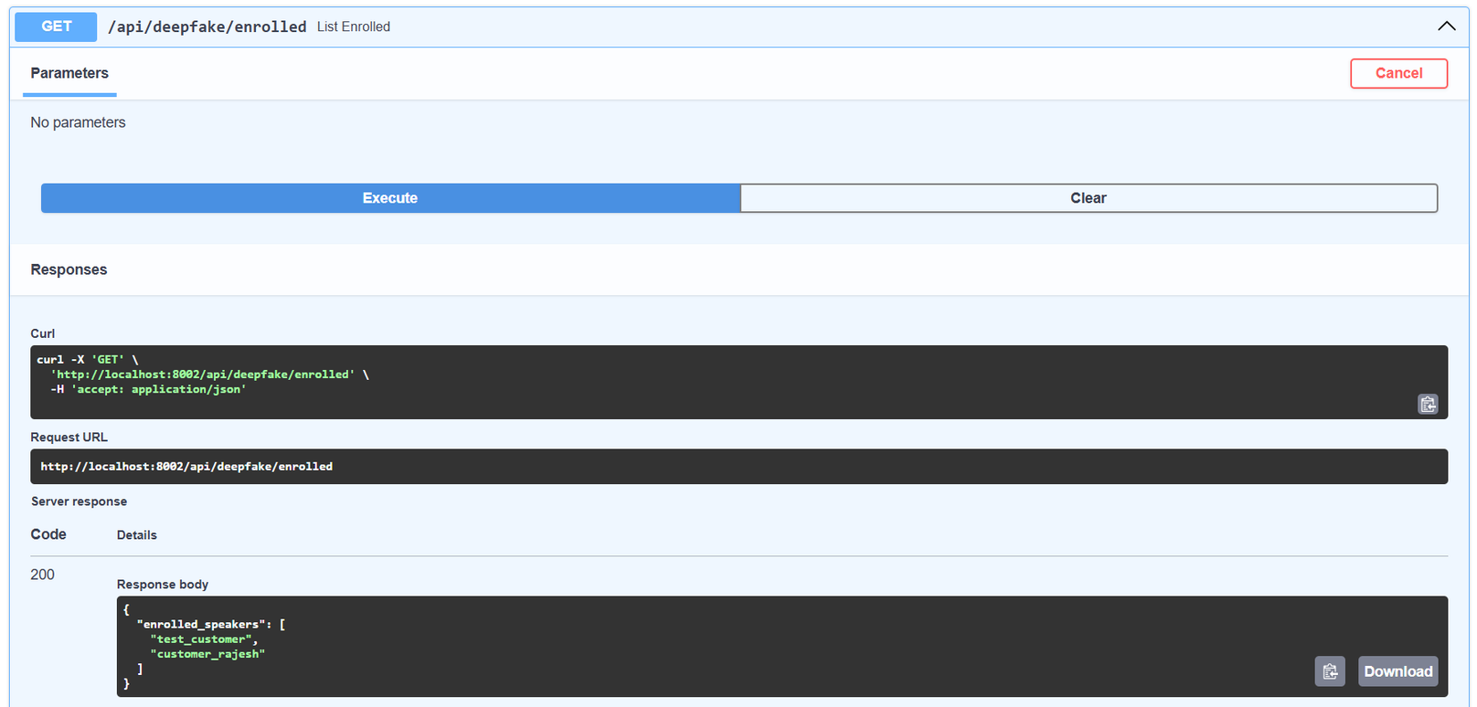
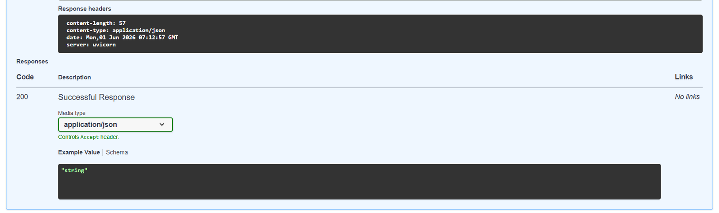
RESULTS
Fig 6: Swagger API- enrollment status

Slide 24
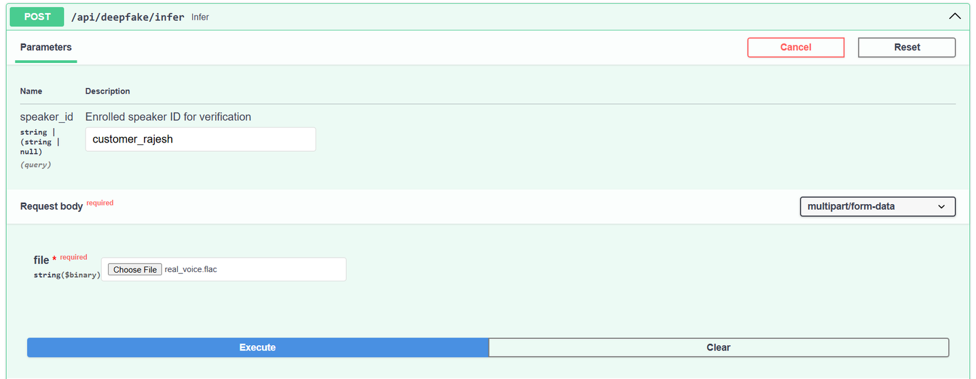
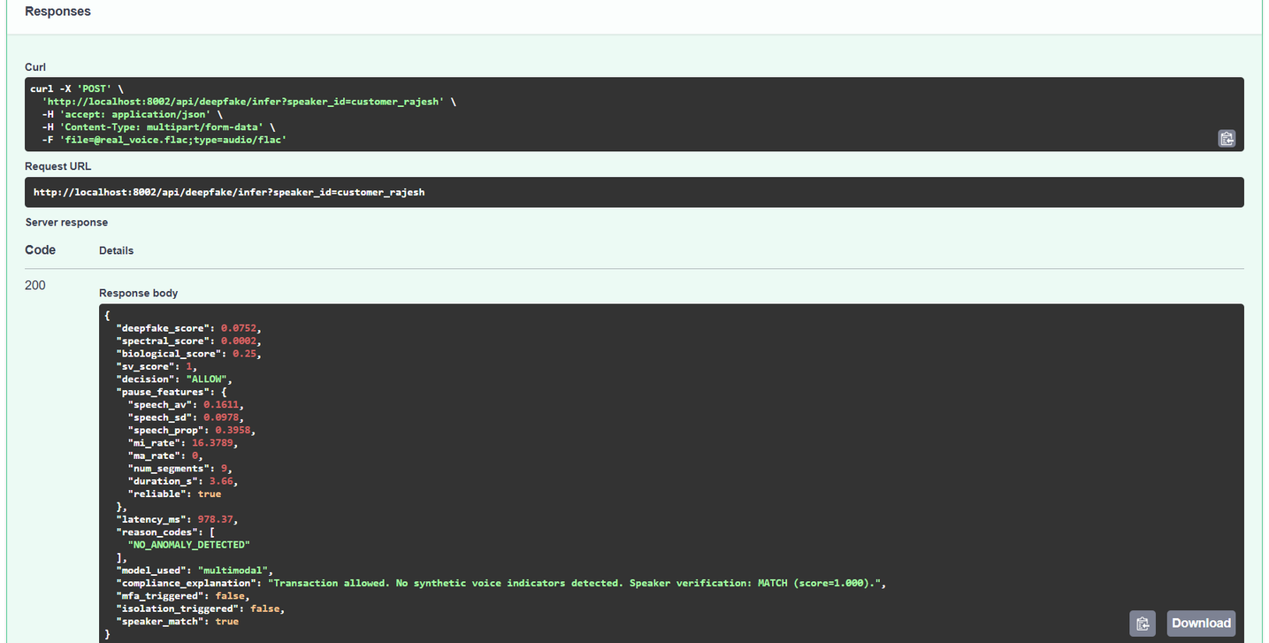
RESULTS
Fig 7: Swagger API- REAL VOICE -infer status

Slide 25
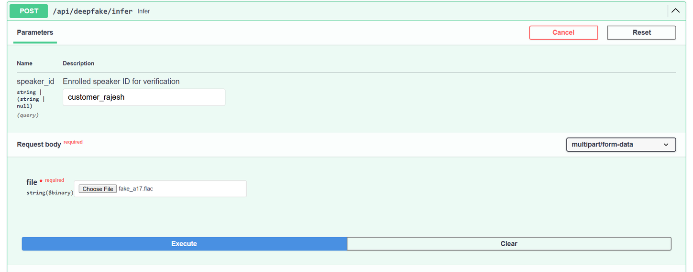
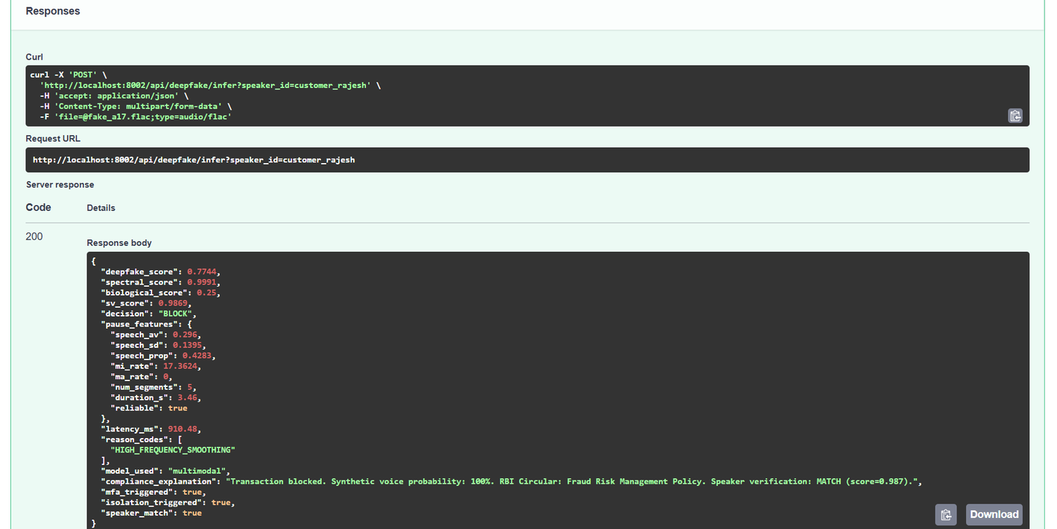
RESULTS
Fig 8: Swagger API- FAKE VOICE -infer status

Slide 26
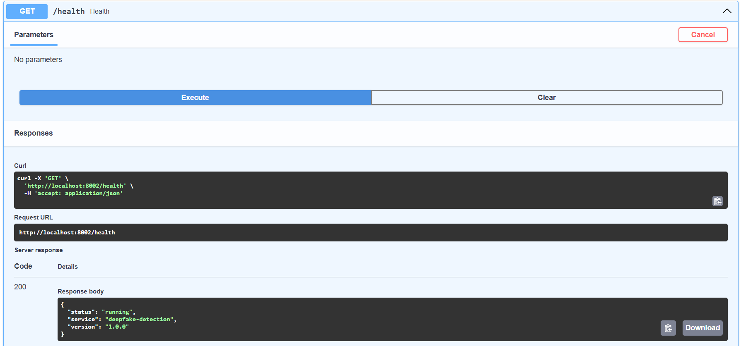
RESULTS
Fig 9: Swagger API- REAL VOICE - SYSTEM status

Slide 27
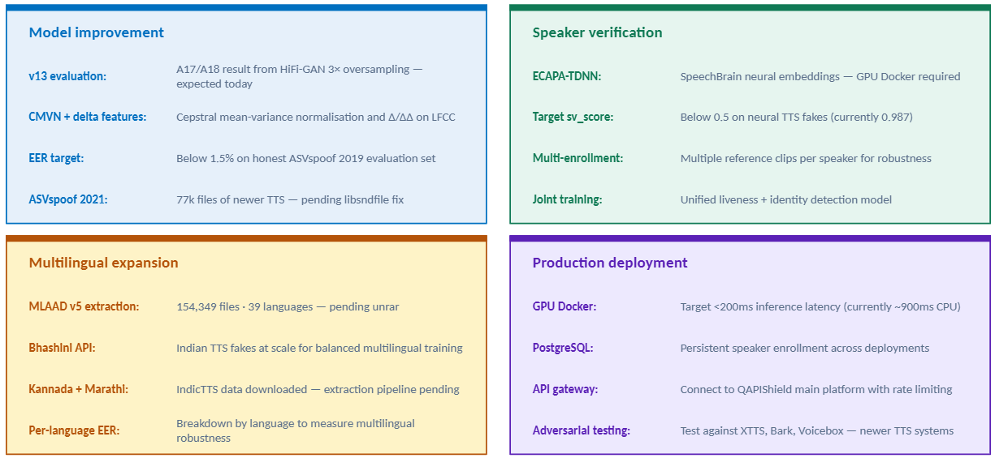
WHAT NEXT

Slide 28



Thank You
info@quantumweaveintelligence.com
https://quantumweaveintelligence.com
+91 9447103005 / 8075867593

